Slide 1


Git, Collaboration & Team Workflow
Understanding Version Control & Team Collaboration
1

Slide 2
Session Agenda
01
02
Version Control Problem
Repository Concept
03
04
Commit & Branch Overview
Centralized vs Distributed VCS
05
06
Real-World Collaboration
Production Rollback Scenario
07
08
GitHub Demo
Merge Conflicts & Code Review
2

Slide 3
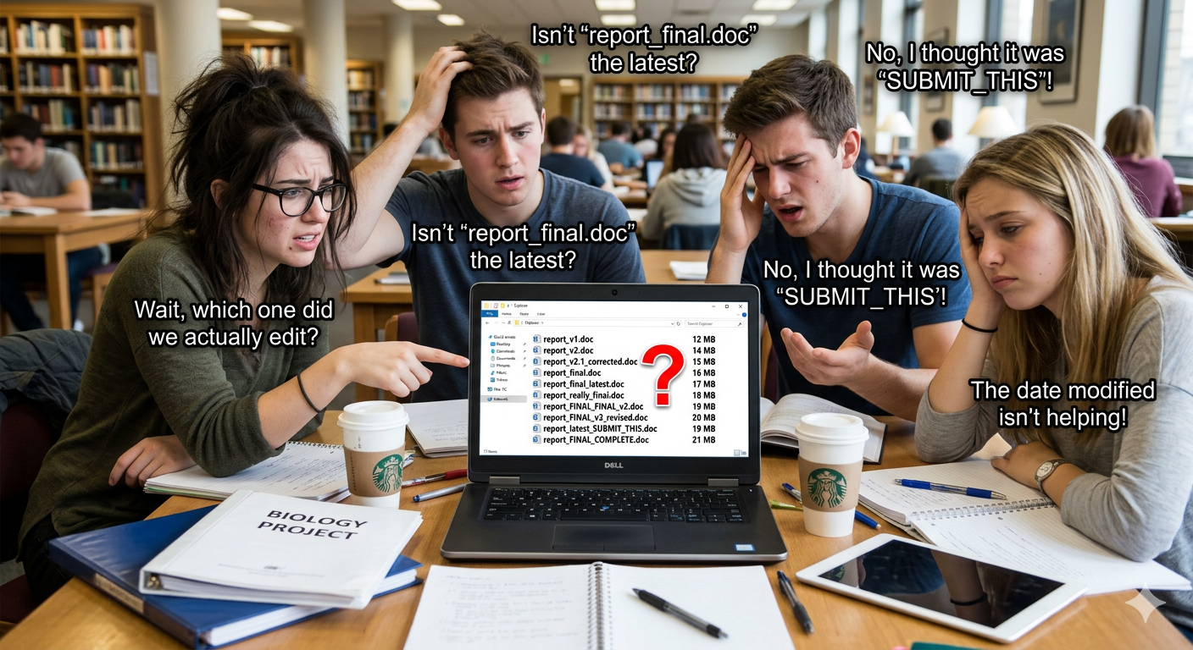

CONCEPT INTRODUCTION
The Version Control Problem
Example: Imagine a group of students working on a project report.
Before Version Control
File_v1, File_v2
Final_file_latest
Final_file_latest_updated
Problems
Confusion & overwriting changes
No history tracking
Hard collaboration
Solution: Version Control System (VCS)
Solution: Using Git, every change is tracked and previous versions can be restored easily.
3

Slide 4
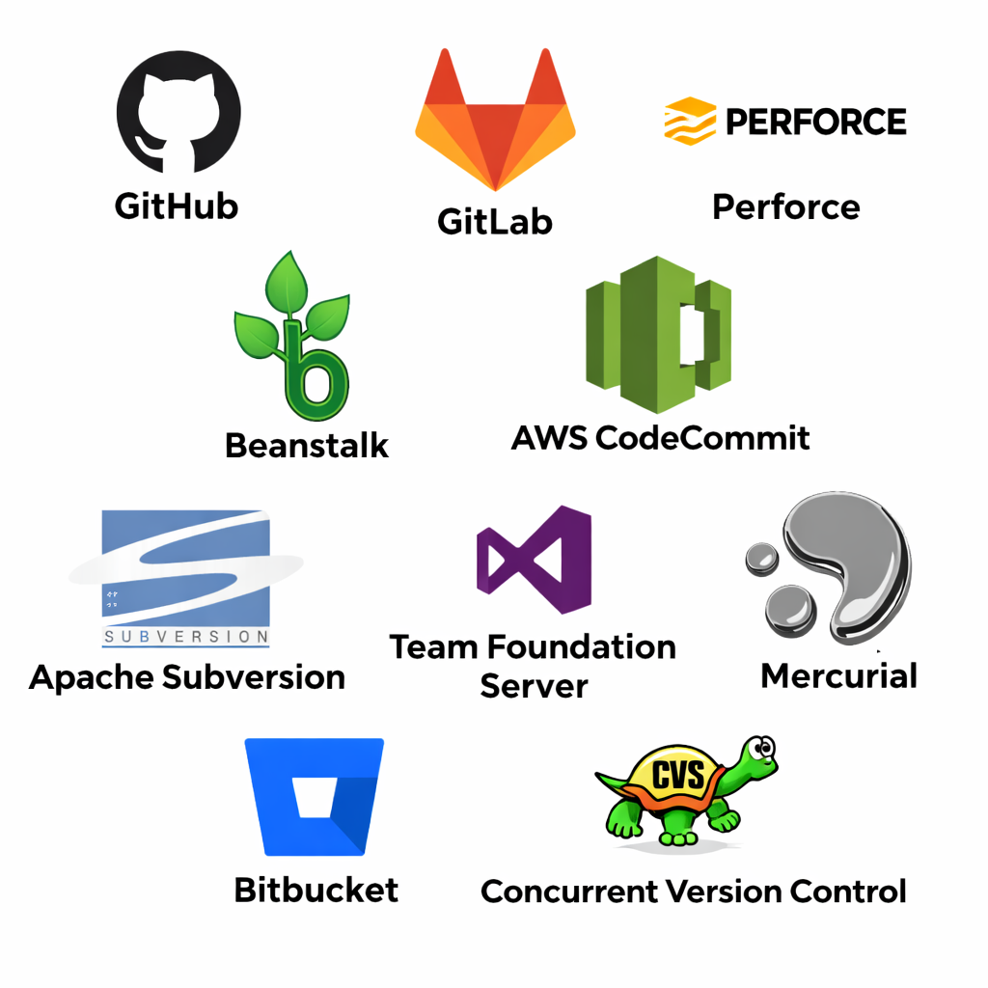
What is Version Control?
Track Changes
Collaborate
Full history of every code modification
Multiple developers working simultaneously
Rollback
Revert to any previous stable state
Popular VCS :
Git, SVN, Mercurial
4

Slide 5

Repository Concept
What is a Repo?
Example 2:
Think of a shared project folder used by a team.
Developers store their project files in a repository on GitHub so everyone in the team can access and contribute to the same project.
A repository stores your code, its full history, and tracks every change over time.
Two Types
Local — on your machine
Remote — on a server (e.g. GitHub)
Example1:
A team building a shopping website keeps all frontend and backend code in one repository.
5

Slide 6
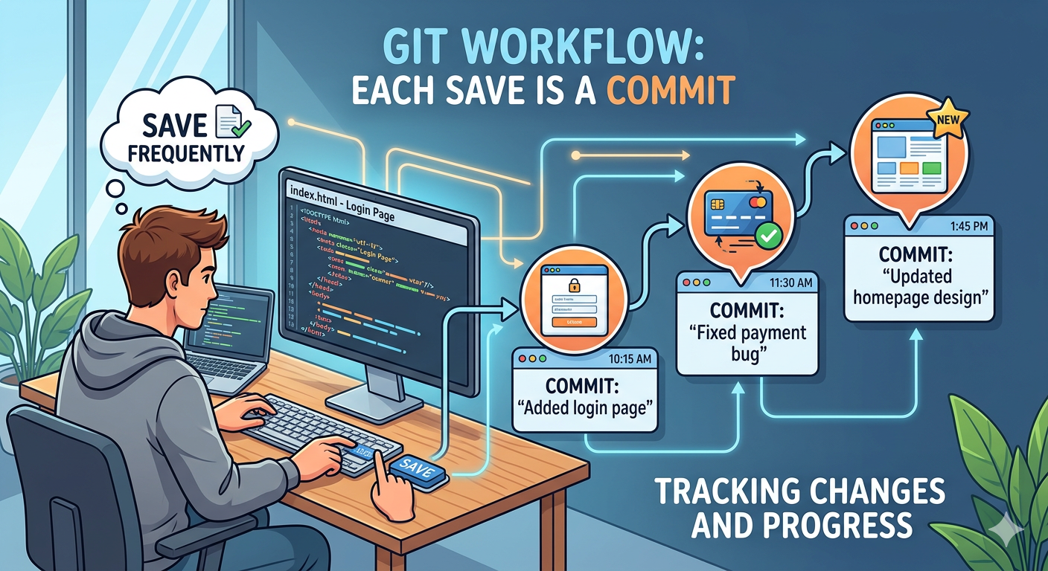
COMMIT & BRANCH OVERVIEW
What is a Commit?
When writing a document, you press Save frequently to avoid losing work.
A Commit is...
A snapshot of code at a point in time
Has a unique ID (hash)
Contains a descriptive message
Examples
"Added login page"
"Fixed payment bug"
"Updated homepage design"
💾 Think of a commit as a save point in a game — you can always return to it.
6

Slide 7
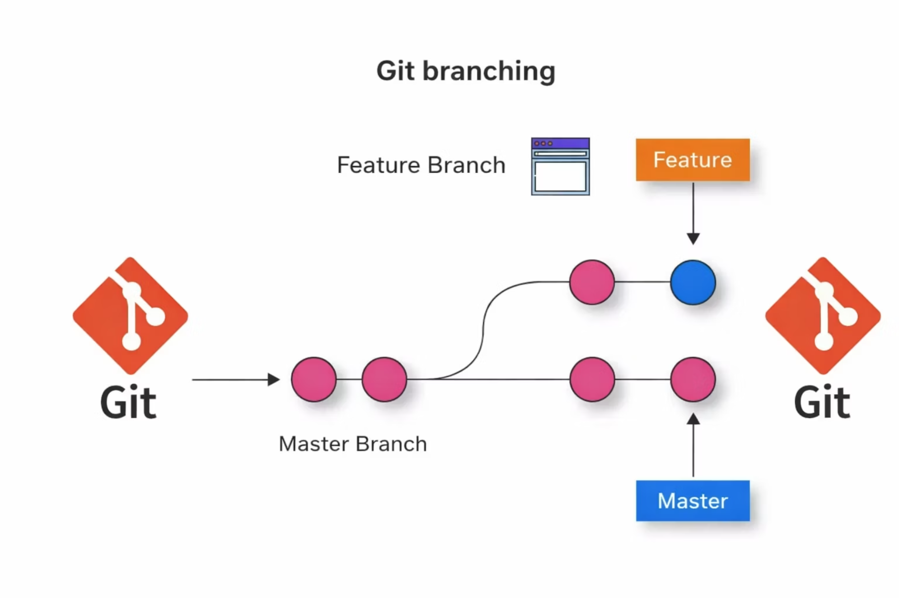
What is a Branch?
Branches allow independent lines of development. The main branch holds production code, while feature branches
(e.g. feature-login) isolate new work until it's ready to merge.
7

Slide 8
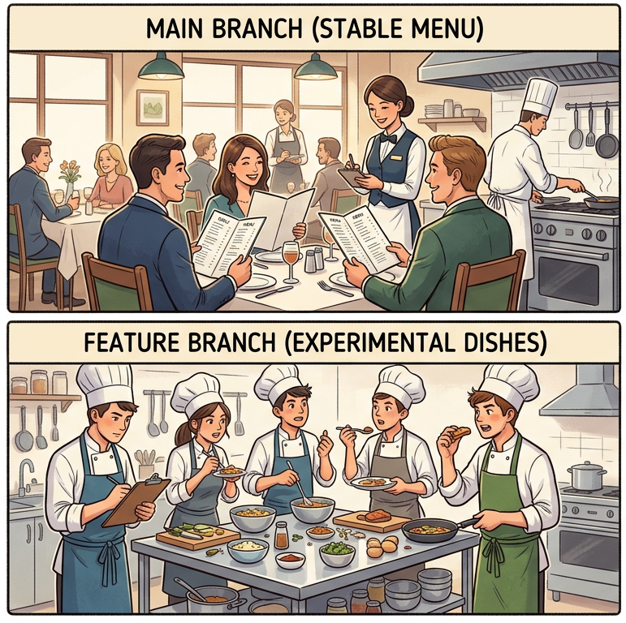
Example of Branch
Example:
Imagine a restaurant updating its menu.
The current menu is used by customers.
But chefs test new dishes separately before adding them to the main menu.
Similarly in Git:
main → stable production code
feature-login → new login system under development
8

Slide 9
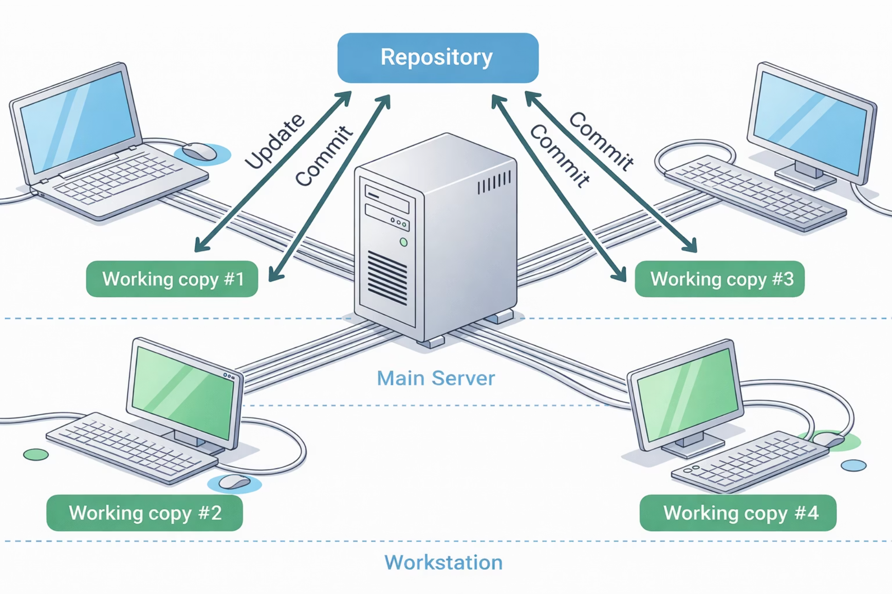

CENTRALIZED VS DISTRIBUTED VCS
Centralized VCS
How It Works
All developers pull from and push to one central server.
Example
SVN (Subversion)
⚠️ Problem: If the server fails, all work stops — single point of failure.
9

Slide 10
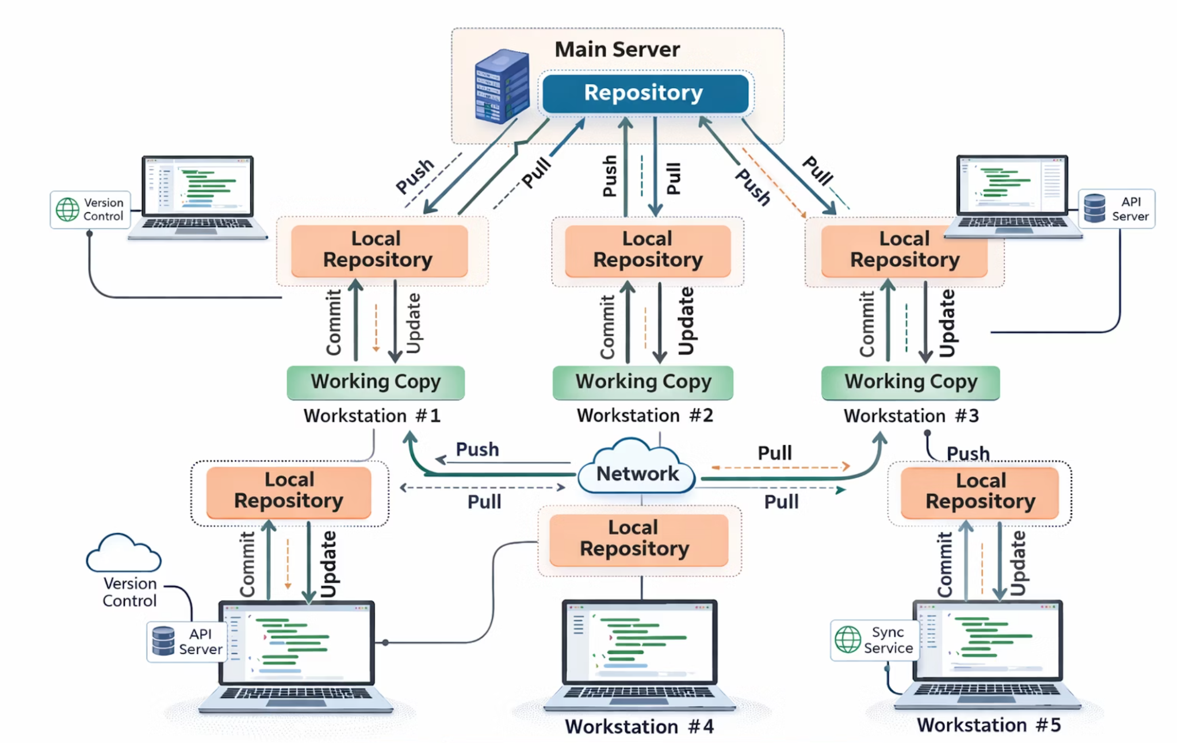
Distributed VCS
How It Works
Every developer has a full copy of the repository locally.
Example
Git
Works offline
Better reliability
No single point of failure
10

Slide 11
Quiz Time
Q1. Why do developers need Version Control?
✅ Answer: Version control helps track changes in files and prevents losing previous versions.
Using Git, all versions are tracked automatically.
Q2. What is a Repository?
✅ Answer: A repository is a storage place for code and its history. Developers usually store repositories on GitHub.
Q3. What is the difference between Local Repo and Remote Repo?
✅ Answer:
Local repo → stored on your personal computer
Remote repo → stored online for the whole team
11

Slide 12
REAL-WORLD EXAMPLES
Multiple Developers, Same Codebase
Developer A
Developer B
Developer C
Login feature branch
Payment feature branch
UI update branch
All working simultaneously without conflict — using branching, pull requests, and code review.
12

Slide 13
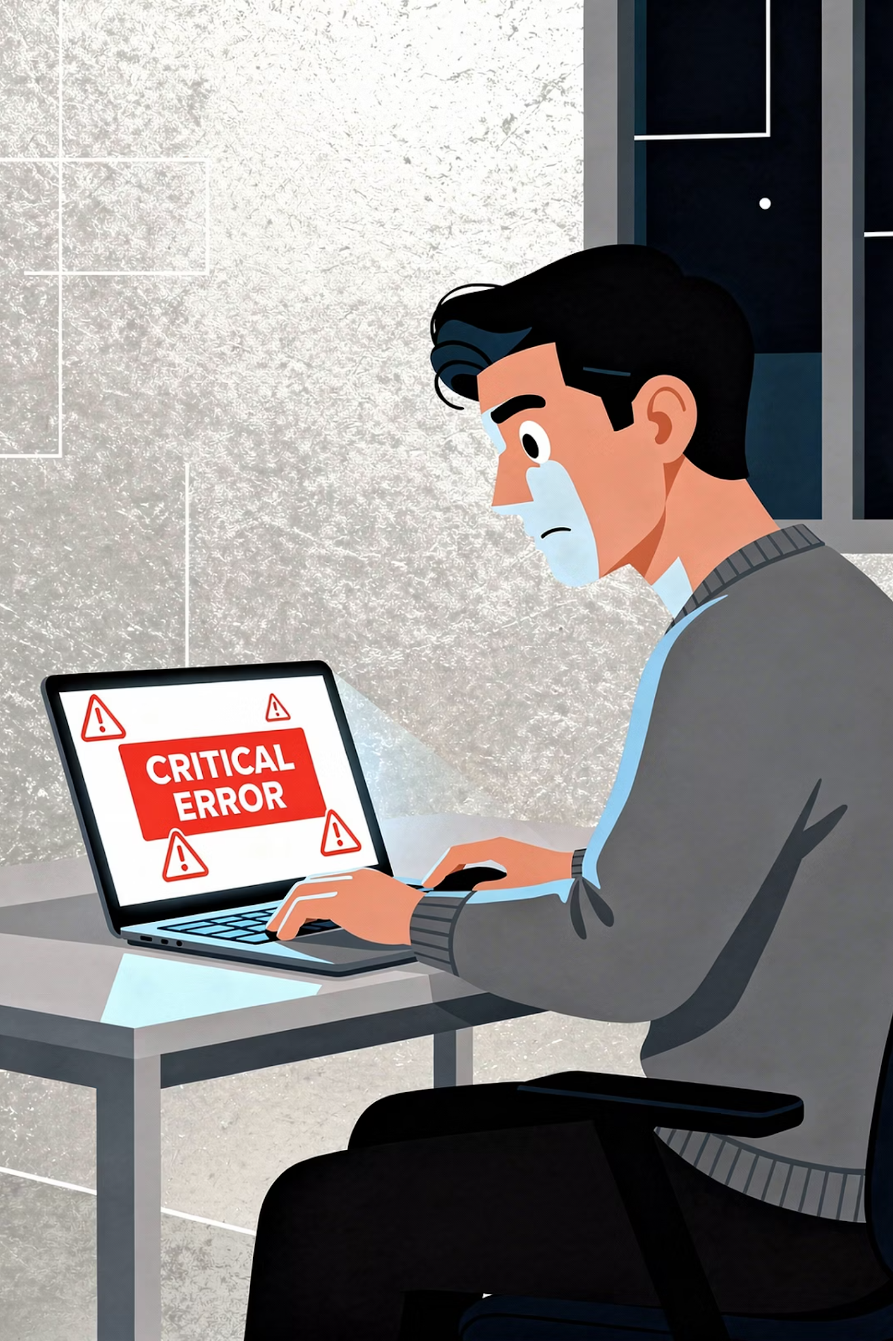



Production Bug Rollback
Bug Found
New release deployed, issue detected in production
Identify Commit
Locate the bad commit in Git history
Revert & Redeploy
Roll back to previous stable commit
Without VCS, restoring the old version is extremely difficult.
13

Slide 14
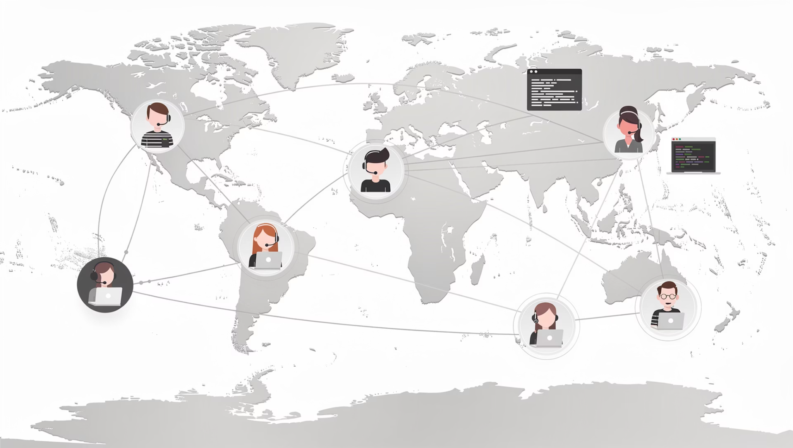
Why Code Collaboration Matters
Modern Development Reality
Teams spread across countries
Multiple contributors per project
Frequent, rapid releases
Collaboration Ensures
Code quality & shared knowledge
Faster development cycles
14

Slide 15




DEMO SECTION
GitHub Repository Interface
Code Tab
Commit History
Browse all project files and folders
View every change ever made
Branch Dropdown
Pull Requests & Issues
Switch between feature branches
Review, discuss, and track work
15

Slide 16
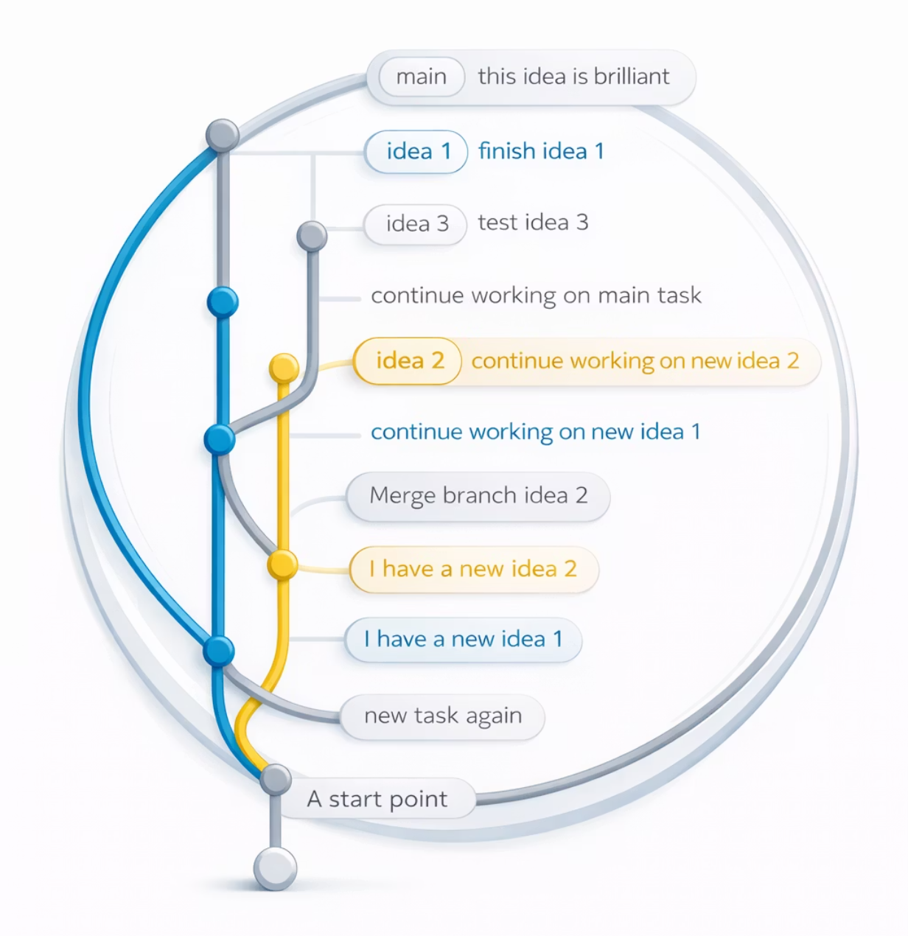
Commit History Visualization
Commit A → Commit B → Commit C
Each commit is linked to the previous one. You can view what changed in any commit — and revert a specific commit if needed.
16

Slide 17
Quiz Time
Q1. What is a Commit?
✅ Answer: A commit is a saved checkpoint of the project.
Example: “Added login page”
Q2. Why do developers create branches?
✅ Answer:
Branches allow developers to work on new features without affecting the main project.
Each person works separately before combining everything.
Branches in Git work the same way.
Q3. Why should developers avoid working directly on the main branch?
✅ Answer:
Because mistakes can break the main project.
Using branches in Git prevents this.
17

Slide 18

SCENARIO DISCUSSION
Handling Merge Conflicts
Communication between developers is key to resolving conflicts quickly.
Example: Two students editing the same Google Docs paragraph at the same time may write different sentences.
1
Identify Conflict
Git flags the conflicting lines in the file
2
Decide Correct Code
Discuss with the other developer
3
Edit the File
Manually resolve the conflict
4
Commit Resolution
Commit the resolved version to the branch
18

Slide 19

Code Review Importance
Example: Before submitting a group assignment, one teammate reviews everyone's work to find mistakes.
Quality Check
Knowledge Sharing
Another developer reviews your code for bugs and standards
Team learns from each other's approaches
Fewer Issues
Catches problems before they reach production
Done via Pull Requests on GitHub.
Benefits
Fewer bugs, Better code quality, Knowledge sharing
19

Slide 20












TEAM WORKFLOW OVERVIEW
Typical Team Workflow
Clone Repository
Create Feature Branch
Make Changes & Commit Locally
Code Review & Merge to Main
Create Pull Request
Push to Remote
20

Slide 21
Why This Workflow Matters
❌ Without Workflow
✅ With Workflow
Code conflicts everywhere
Broken production
Blame culture
Organized development
Faster, stable releases
Shared accountability
21

Slide 22
DISCUSSION
Discussion
1
What happens if two developers edit the same file?
2
Why not work directly on the main branch?
3
Is Git enough without GitHub?
4
Why are commit messages important?
5
Should every change go through review?
22

Slide 23
Key Takeaways
Version Control
Repos & Commits
Branches
Solves chaos of manual file management
Store code history as revertible snapshots
Isolate features safely from production
Git vs SVN
Merge & Review
Distributed beats centralized for reliability
Resolve conflicts, ensure quality via PRs
23

Slide 24


Thank You
24

